Slide 1
Kellect4APT Dataset
Zhejiang Innovation center of Cyberspace Security

Slide 2

Kellect4APT Dataset
Kellect4APT uses the open-source collector Kellect for data collection.
Kellect is a real-time, non-invasive, efficient Windows kernel log collector that can provide rich kernel behavior data as the basis for user and application behavior.
The dataset involves 9 tactics with 43 sub-techniques and 304 sample files, totaling 18.5GB.
Every sample contains only 1 TTP.
Each sample includes only 1 script.
The ETW formatted log has no label but they provided a csv file specified every TTP events
The size for each sample is not large
Txxxx
Txxxx-1
Txxxx-2
Txxxx …

Slide 3
Data collection environment
Based on Windows 10, the CPU of the host is i5-10400F, the GPU is 1050ti, the memory is 16GB.
Data was collected with specified noise and scripts running.
Noise 1 | Video live streaming and common office software
Noise 2 | Gaming and file downloading

Slide 4
log example
{"Event": "RegistryQuery", "PID": 7928, "PName": "conhost.exe", "PPID": 2412, "PPName": "powershell.exe", "TID": 7868, "TimeStamp": 133341559560493051, "Host-UUID": "FBFFA15C-FEDE-4f96-9AF8-398294758A2A", "args": {"Index": 7, "InitialTime": 593909697, "KeyHandle": 784855216, "KeyName": "", "Status": 0}}
欄位名稱 | 範例值 | 欄位說明
Event | "RegistryQuery" | 事件類型：標示當前系統呼叫的具體動作。
KeyName | "" (空字串) | 目標對象路徑：這裡指被操作的登錄檔鍵值。空字串通常代表正在列舉子鍵或查詢預設值。
Status | 0 | 執行狀態碼：0 代表成功 (STATUS_SUCCESS)。
KeyHandle | 784855216 | 作業系統分配給該登錄檔的記憶體指標，用於追蹤同一行程對同一物件的連續操作。
Index / InitialTime | 7 / 593909697 | OS 底層遍歷登錄檔時的索引與初始化時間，通常用於極深度的系統狀態取證。

Slide 5
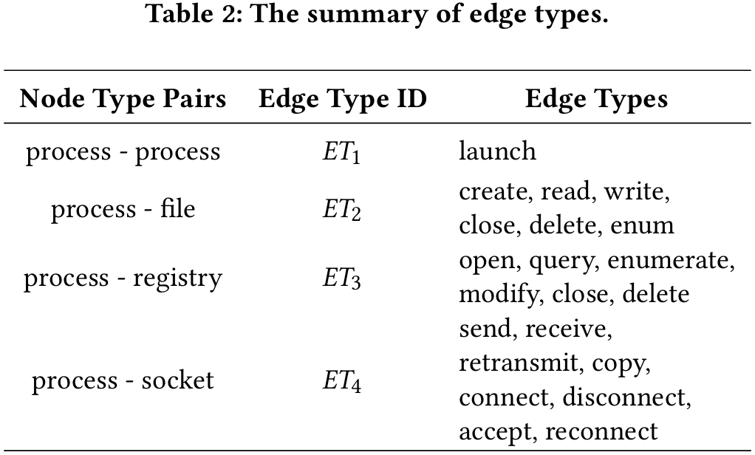
Collection content
Referring to the events provided by Windows, we collect and analyze a total of the following seven events, which are included as follows:
TCP/IP | TcpIpSendIPV4, TcpIpSendIPV6, TcpIpRetransmitIPV4, TcpIpRetransmitIPV6, TcpIpRecvIPV4, TcpIpRecvIPV6, TcpIpConnectIPV4, TcpIpReconnectIPV6, TcpIpConnectIPV6, TcpIpReconnectIPV4, TcpIpAcceptIPV4, TcpIpAcceptIPV6, TcpIpDisconnectIPV4, TcpIpDisconnectIPV6
FileIO | FileIOWrite, FileIORead, FileIOFileCreate, FileIORename, FileIOCreate, FileIOCleanup, FileIOFlush, FileIOClose, FileIODelete, FileIOFileDelete
Registry | RegistryCreate, RegistrySetValue, RegistryDeleteValue, RegistryOpen, RegistryDelete, RegistryFlush, RegistryClose, , RegistrySetInformation, RegistryQuery, RegistryQueryValue
Process | ProcessStart, ProcessEnd, ProcessDCStart, ProcessDCEnd | Image | ImageDCStart, ImageLoad
Thread | ThreadStart, ThreadEnd, ThreadDCStart, ThreadDCEnd | DiskIO | DiskIOWrite, DiskIORead

Slide 6
Collection content - Common properties
In this case, each event has two parts of attributes: public and private attributes. Each public is described as follows:
Event | corresponding event name
TID | ID of the thread that generated the event
PID | ID of the process that generated the event
PName | name of the process that generated the event
PPID | parent ID of the process that generated the event

Slide 7
Collection content - Common properties
In this case, each event has two parts of attributes: public and private attributes. Each public is described as follows:
PPName | parent name of the process that generated the event
TimeStamp | time of the event occurred
Host-UUID | the host ID that generated the event, distinguish the specific log source in the joint analysis of multi-host logs
Args | private property pairs for specific event types

Slide 8
Collection content - Private properties - file_create event
In this case, each event has two parts of attributes: public and private attributes. Each public is described as follows: This type properties is various depends on the BaseEvent types.
IrpPtr | IO request packet
TTID | Thread identifier of the thread that is creating the file
FileObject | Identifier that can be used for correlating operations to the same opened file object instance between file create and close events
CreateOptions | Values passed in the CreateOptions and CreateDispositions parameters to the NtCreateFile function
FileAttributes | Value passed in the FileAttributes parameter to the NtCreateFile function
ShareAccess | Value passed in the ShareAccess parameter to the NtCreateFile function
OpenPath | Path to the file

Slide 9
Collection content - Private properties - FileIo_Name event
In this case, each event has two parts of attributes: public and private attributes. Each public is described as follows: This type properties is various depends on the BaseEvent types.
FileObject | Match the value of this pointer to the FileObject pointer value in a DiskIo_TypeGroup1 event to determine the type of I/O operation
FileName | Full path to the file, not including the drive letter

